Slide 1
Refactoring
By Martin Fowler
Presented by Ivan Pavlov

Slide 2
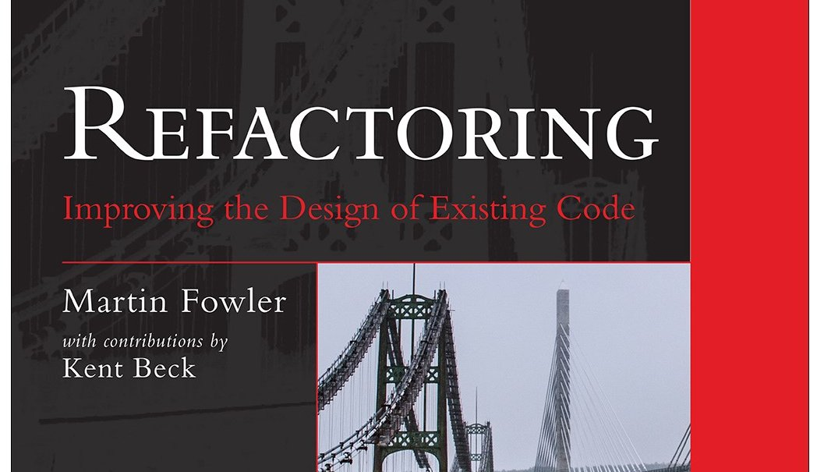
Refactoring

Slide 3
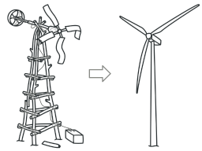
Refactoring
What is refactoring?
Why do we need to refactor?
When should we refactor?
How to refactor?

Slide 4
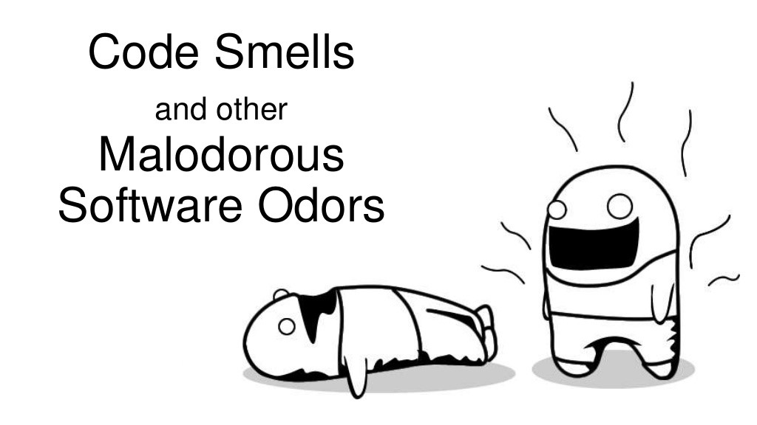
Code smells
Bloaters
OO Abusers
Change preventers
Dispensables
Couplers

Slide 5

Bloaters
Long method
Large class
Primitive obsession (Overused primitives)
Long parameter list
Data clumps
Combinatorial explosion
Class doesn’t do much
Required setup/teardown code

Slide 6
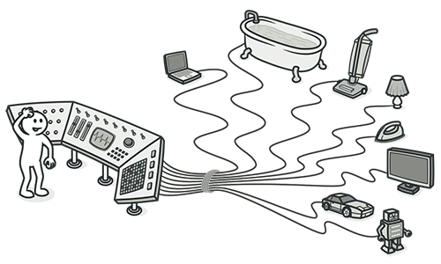
Object oriented abusers
Switch statements
Temporary field
Refused bequest
Alternative classes with
Different interfaces

Slide 7

Change preventers
Divergent change
Shotgun surgery
Parallel inheritance hierarchies
Conditional complexity

Slide 8
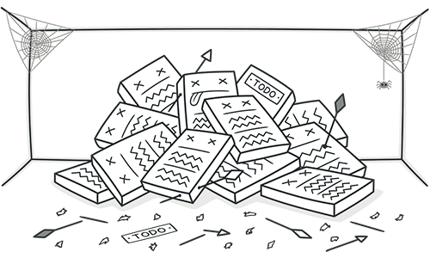
Dispensables
Comments
Duplicate code
Lazy class
Dead code
Data class

Slide 9
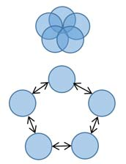
Couplers
Feature envy
Inappropriate intimacy
Indecent exposure
Middle man

Slide 10
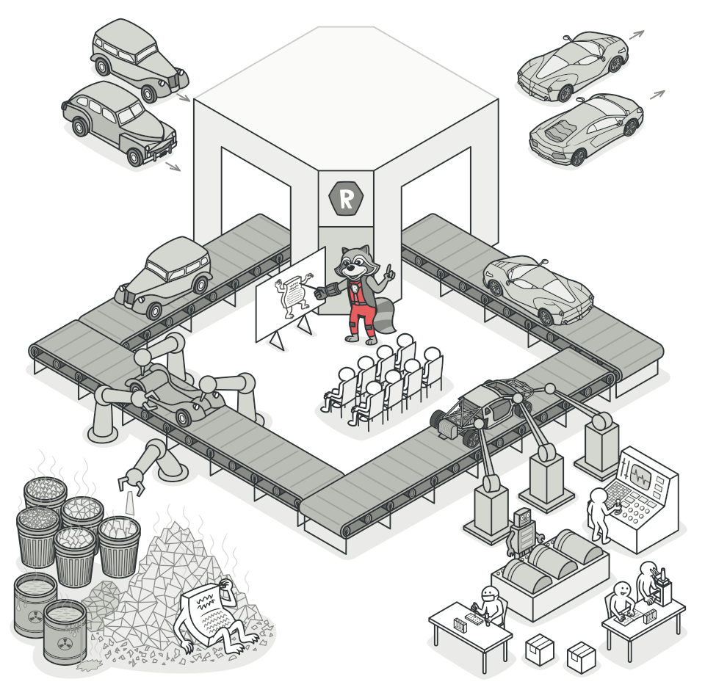
Refactoring
Data level refactoring
Statement level refactoring
Method level refactoring
Class level refactoring
System level refactoring

Slide 11
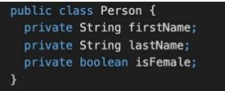
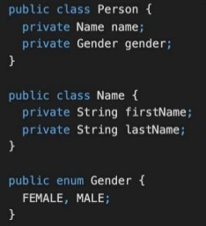
Primitive obsession
Replace data value with object
Replace array with object
$row = [];
$row[0] = "Liverpool";
$row[1] = 15;
$row = new Performance;
$row->setName("Liverpool");
$row->setWins(15);
Before
Before
After
After

Slide 12
Decompose conditional
Before
After
if ($date->before(SUMMER_START) || $date->after(SUMMER_END)) {
$charge = $quantity * $winterRate + $winterServiceCharge;
} else {
$charge = $quantity * $summerRate;
}
if (isSummer($date)) {
$charge = summerCharge($quantity);
} else {
$charge = winterCharge($quantity);
}

Slide 13
Decompose
Before
After
switch ($token):
case '+':
return true;
case '-':
return true;
case '*':
return true;
case '/':
return true;
case '%':
return true;
default:
return false;
endswitch;
return in_array($token, ['-', '+', '*', '/', '%']);

Slide 14
Replace method with method object
Before
After
class Order {
// ...
public function price() {
$primaryBasePrice = 10;
$secondaryBasePrice = 20;
$tertiaryBasePrice = 30;
// Perform long computation.
}
}
class Order {
// ..
. public function price() {
return (new PriceCalculator($this))->compute();
}
}
class PriceCalculator {
private $primaryBasePrice;
private $secondaryBasePrice;
private $tertiaryBasePrice;
public function __construct(Order $order) {
// Copy relevant information from the
// order object.
}
public function compute() {
// Perform long computation.
}
}

Slide 15
Substitute algorithm
Before
After
function foundPerson(array $people){
for ($i = 0; $i < count($people); $i++) {
if ($people[$i] === "Don") {
return "Don"; }
if ($people[$i] === "John") {
return "John"; }
if ($people[$i] === "Kent") {
return "Kent";
}
}
return "";
}
function foundPerson(array $people){
foreach (["Don", "John", "Kent"] as $needle) {
$id = array_search($needle, $people, true);
if ($id !== false) {
return $people[$id];
}
}
return "";
}

Slide 16
Data level refactoring
Replace a magic number with a named constant (variable)
Replace a variable with a more informative name
Replace an expression with a method
To simplify or avoid code duplication
Move an expression inline
Introduce an intermediate variable
Introduce an explanatory variable
Convert a multi-use variable to multiple single-use variables
Create a separate variable for each usage

Slide 17
Data level refactoring
Create a local variable for local purposes rather than a parameter
Convert a data primitive to a class
Additional behavior / validation logic (money)
Convert a set of type codes (constants) to enum
Convert a set of type codes to a class with subclasses with different behavior
Change an array to an object
When you use an array with different types in it
Encapsulate a collection (list of cards => deck)

Slide 18
Statement level refactoring
Move a complex Boolean expression into a well named Boolean function
Consolidate duplicated code in conditionals
Return as soon as you know an answer instead of assigning a return value
Use break or return instead of a loop control variable
Replace conditionals with polymorphism
Use null objects instead of testing for nulls

Slide 19
Method level refactoring
Extract method/ Inline method
Rename method
Convert a long routine to a class
Add / Remove parameter
Combine similar methods by parameterizing them
Substitute a complex algorithm with a simpler one
Separate methods whose behavior depends on parameters passed in (create new ones)
Pass a whole object rather than specific fields
Encapsulate downcast / Return interface types

Slide 20
Class level refactoring
Pull members up/ push members down hierarchy
Extract specialized code into a subclass
Combine similar code into a superclass
Collapse hierarchy
Replace inheritance with delegation
Replace delegation with inheritance

Slide 21
Class interface refactoring
Extract interface(s)/ Keep interface segregation
Move a method to another class
Convert a class to two
Delete a class
Hide a delegating class ( A calls B and C when A should call B and b call C)
Remove the man in the middle
Introduce ( use ) an extension class
When you have no access to the original class
Decorator pattern

Slide 22
Class interface refactoring
Encapsulate an exposed member variable
Use properties
Define proper access to getters and setters
Hide data and routines that are not intended to be used outside of the class/ hierarchy
Private->protected->public
Avoid big class hierarchies

Slide 23
System level refactoring
Move class ( set of classes ) to another namespace
Provide a factory method instead of a simple constructor
Replace error codes with exceptions
Extract strings to resource files
Use dependency injection
Apply architecture patterns

Slide 24

Thank you

